Slide 1



Modeling of Thermal Protection Systems During Reentry
Presented by Cameron Fernandez
Mentored by Dr. Kyle Hanquist at the University of Arizona
Arizona Space Grant Consortium Symposium
Tucson, AZ
April 23, 2022
Notes:
Hello, my name is Cameron Fernandez, and I am presenting on the modeling of a thermal protection system during atmospheric reentry. I was mentored by Dr. Kyle Hanquist of the University of Arizona's Aerospace and Mechanical Engineering Department.

Slide 2
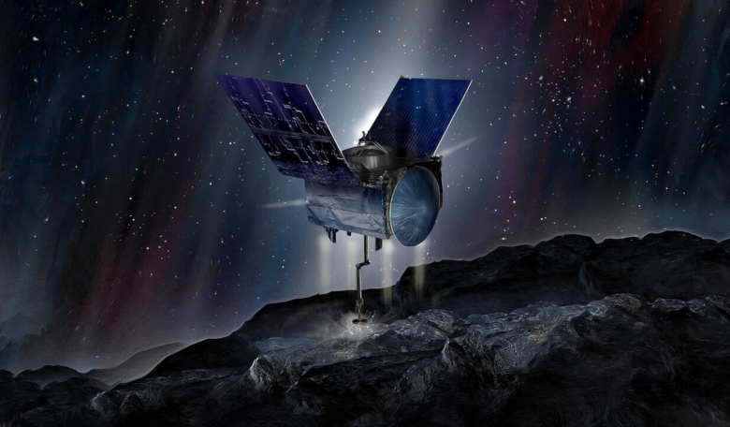
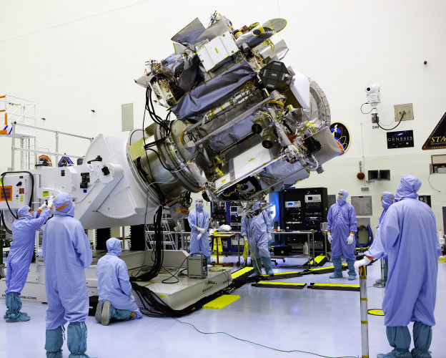
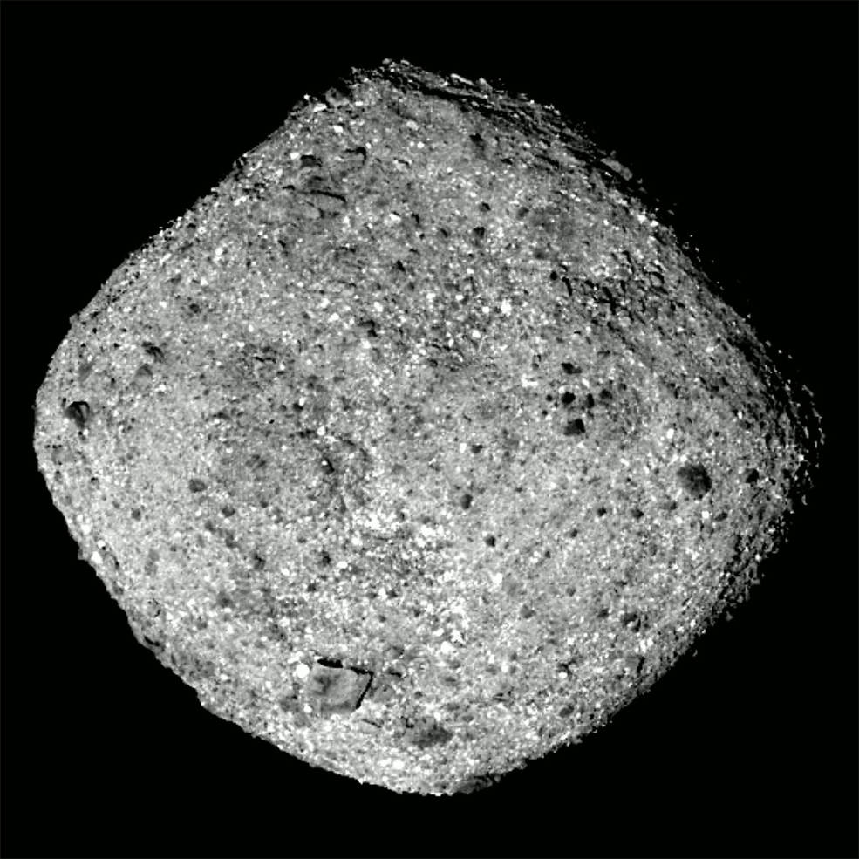
OSIRIS-REx
[2]
[1]
[3]
[1] – OSIRIS-REx Assembly by Dimitri Gerondidakis
[2] – OSIRIS-REx on Bennu as an Artist’s Rendition
[3] – Bennu by OSIRIS-REx, NASA
Notes:
The goal of this project was to model the thermal performance of OSIRIS-Rex’s sample return capsule. OSRIS-REx is a satellite that travelled to the asteroid Bennu, shown in the bottom right, to collect a rock sample for return to Earth. Bennu is of interest to scientists for a few reasons, with the main one being that its composition will give more insight into how the planets of our solar system were formed. The left image shows OSIRIS-REx’s final assembly for scale and the top right image shows an artist's rendition of the satellite collecting the sample. The samples were collected in October of 2020 and are currently on their way back to Earth. The sample is contained in the sample return capsule which is shown here *Laser pointer to top right of left image*

Slide 3
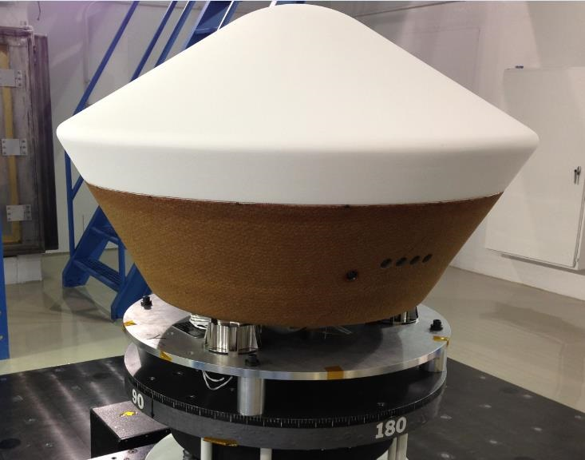
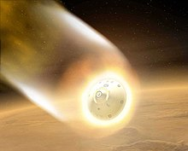
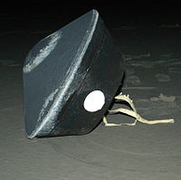
Reentry Vehicles
[2]
[1]
[3]
[1] – Atmospheric Reentry as an Artist’s Rendition
[2] – OSIRIS-REx Sample Return Capsule by NASA
[3] – Stardust Capsule After Reentry by NASA
Notes:
In order to study the sample, we need it to be on Earth, which means that it must enter the atmosphere. To accomplish this, the sample is placed inside of the sample return capsule shown in the top right. The capsule separates from the main body of the satellite before it enters the atmosphere. The left Image shows an artist's rendition of the reentry process, where the capsule will experience heating to a few thousand Kelvin. At a speed of over 10km/s, the air around the capsule ionizes causing very high heat flux, as well as a communications blackout lasting a few minutes. The forces on the capsules are also incredibly high, with OSIRIS-REx's expected to have a peak deceleration of over 30g’s. The bottom right image shows a capsule from a previous mission after having entered the atmosphere. You can see that the surface is charred from the reentry process. These two images highlight one of the reasons understanding the performance of the capsule is important: ensuring that the samples are protected from damage.

Slide 4
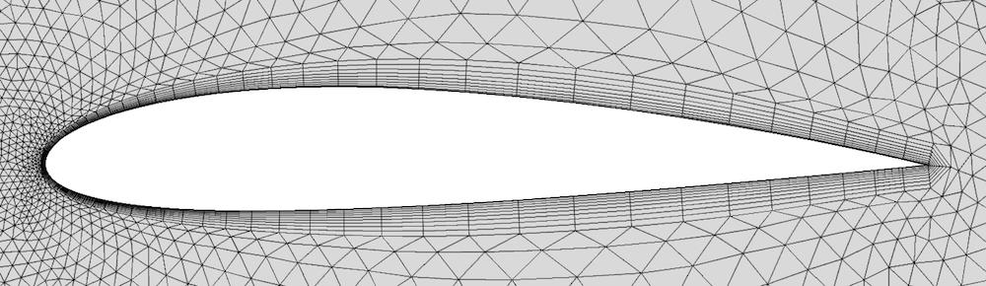
Computational Fluid Dynamics (CFD)
Break area into subsections -> Mesh
Solving:
Keep track of physical and chemical properties of each section
Interpolate from properties of neighboring cells
Iterate until a stable solution
Notes:
One way to determine the performance of the capsule is to use a computational fluid dynamics, or CFD, solver. CFD solvers start by taking an existing mesh of small areas, called cells, and boundary conditions surrounding the model. An example mesh for flow around the cross section of an airplane wing is shown here. Meshes can be either 2 or 3 dimensional depending on the situation. The flow properties within the mesh are then determined when the chosen CFD solver iterates to a stable solution using governing equations. These equations typically include the laws of conservation of mass, momentum, and energy, and can include many more. The accuracy of the solution significantly depends on the physical and chemical phenomenon considered by the solver.

Slide 5

CFD Solvers
PATO – Pourous material Analysis Toolbox based on OpenFoam
Developed by NASA
Open Source
LeMANS
Originally developed by University of Michigan
Requires special permission
High Performance Computer (HPC) – for faster computing
Notes:
For this project it was important to use a CFD solver that could properly model chemical reactions in the air. Since the capsule will be traveling at approximately 12 km/s, the air around it will become ionized and will experience chemical reactions that affect the flow. Initially this project was supposed to use a NASA CFD code called PATO, as it was designed to model these reactions. However, after several months of effort it was determined that getting PATO working on UArizona’s high performance computer was outside the scope of the project. From there, I switched to using a CFD code called LeMANS. This program was developed at the University of Michigan, and still had all the necessary functionality to analyze the capsule. To reduce the impact to my personal computer, the university's high-performance computer was used, allowing for simulations to run for several days at a time. Once I had a working solver and a way to run it, it was time to make the mesh.

Slide 6
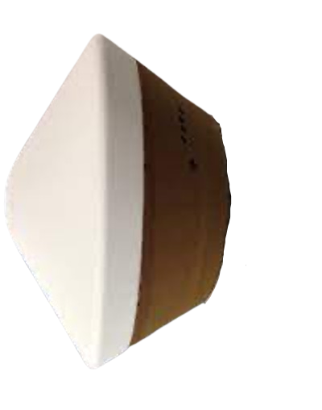
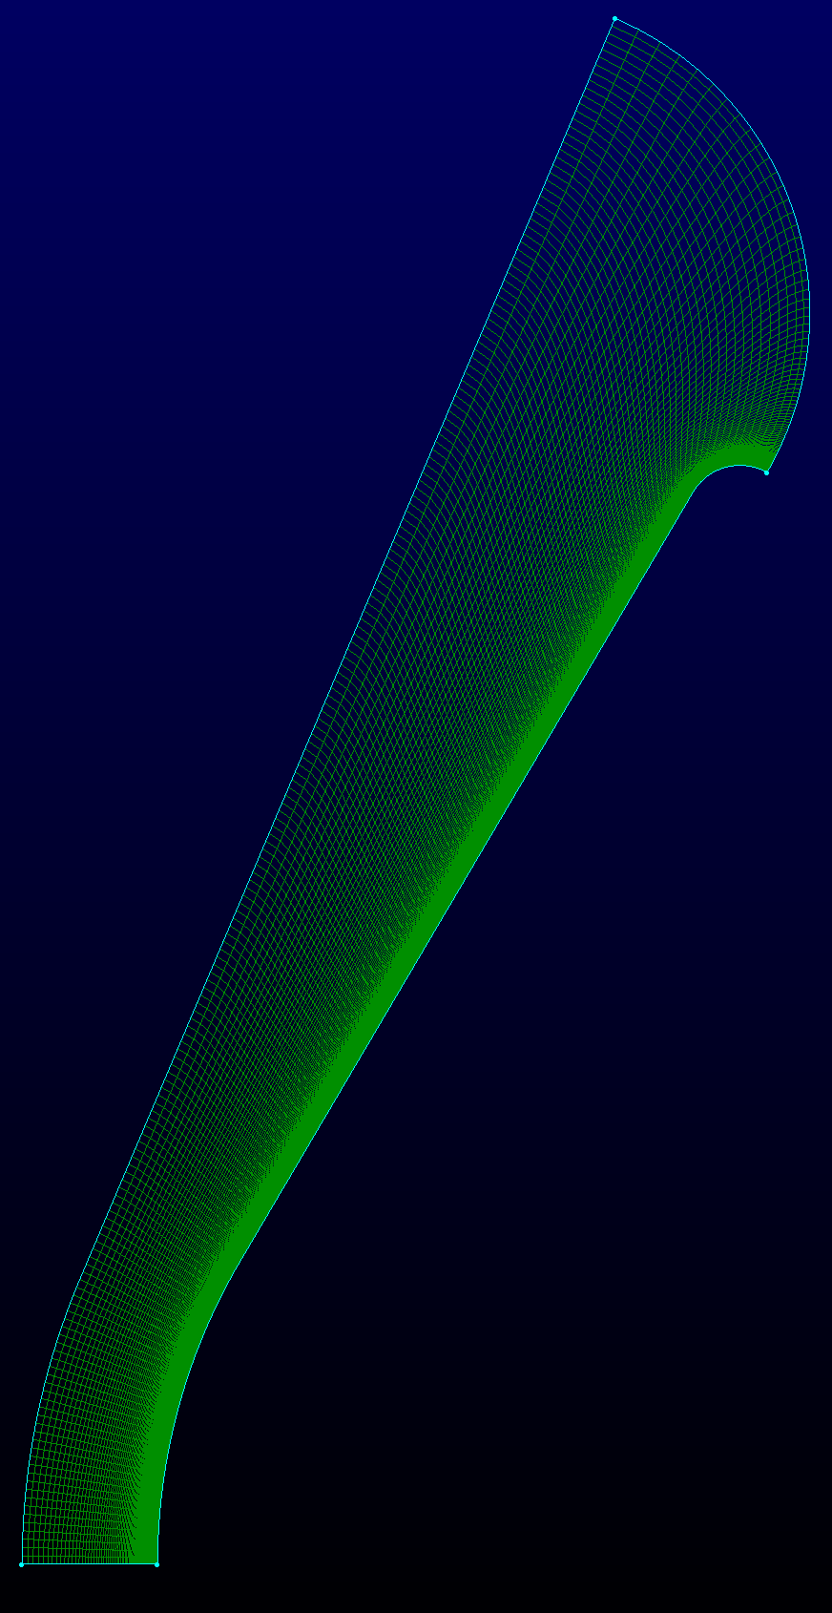
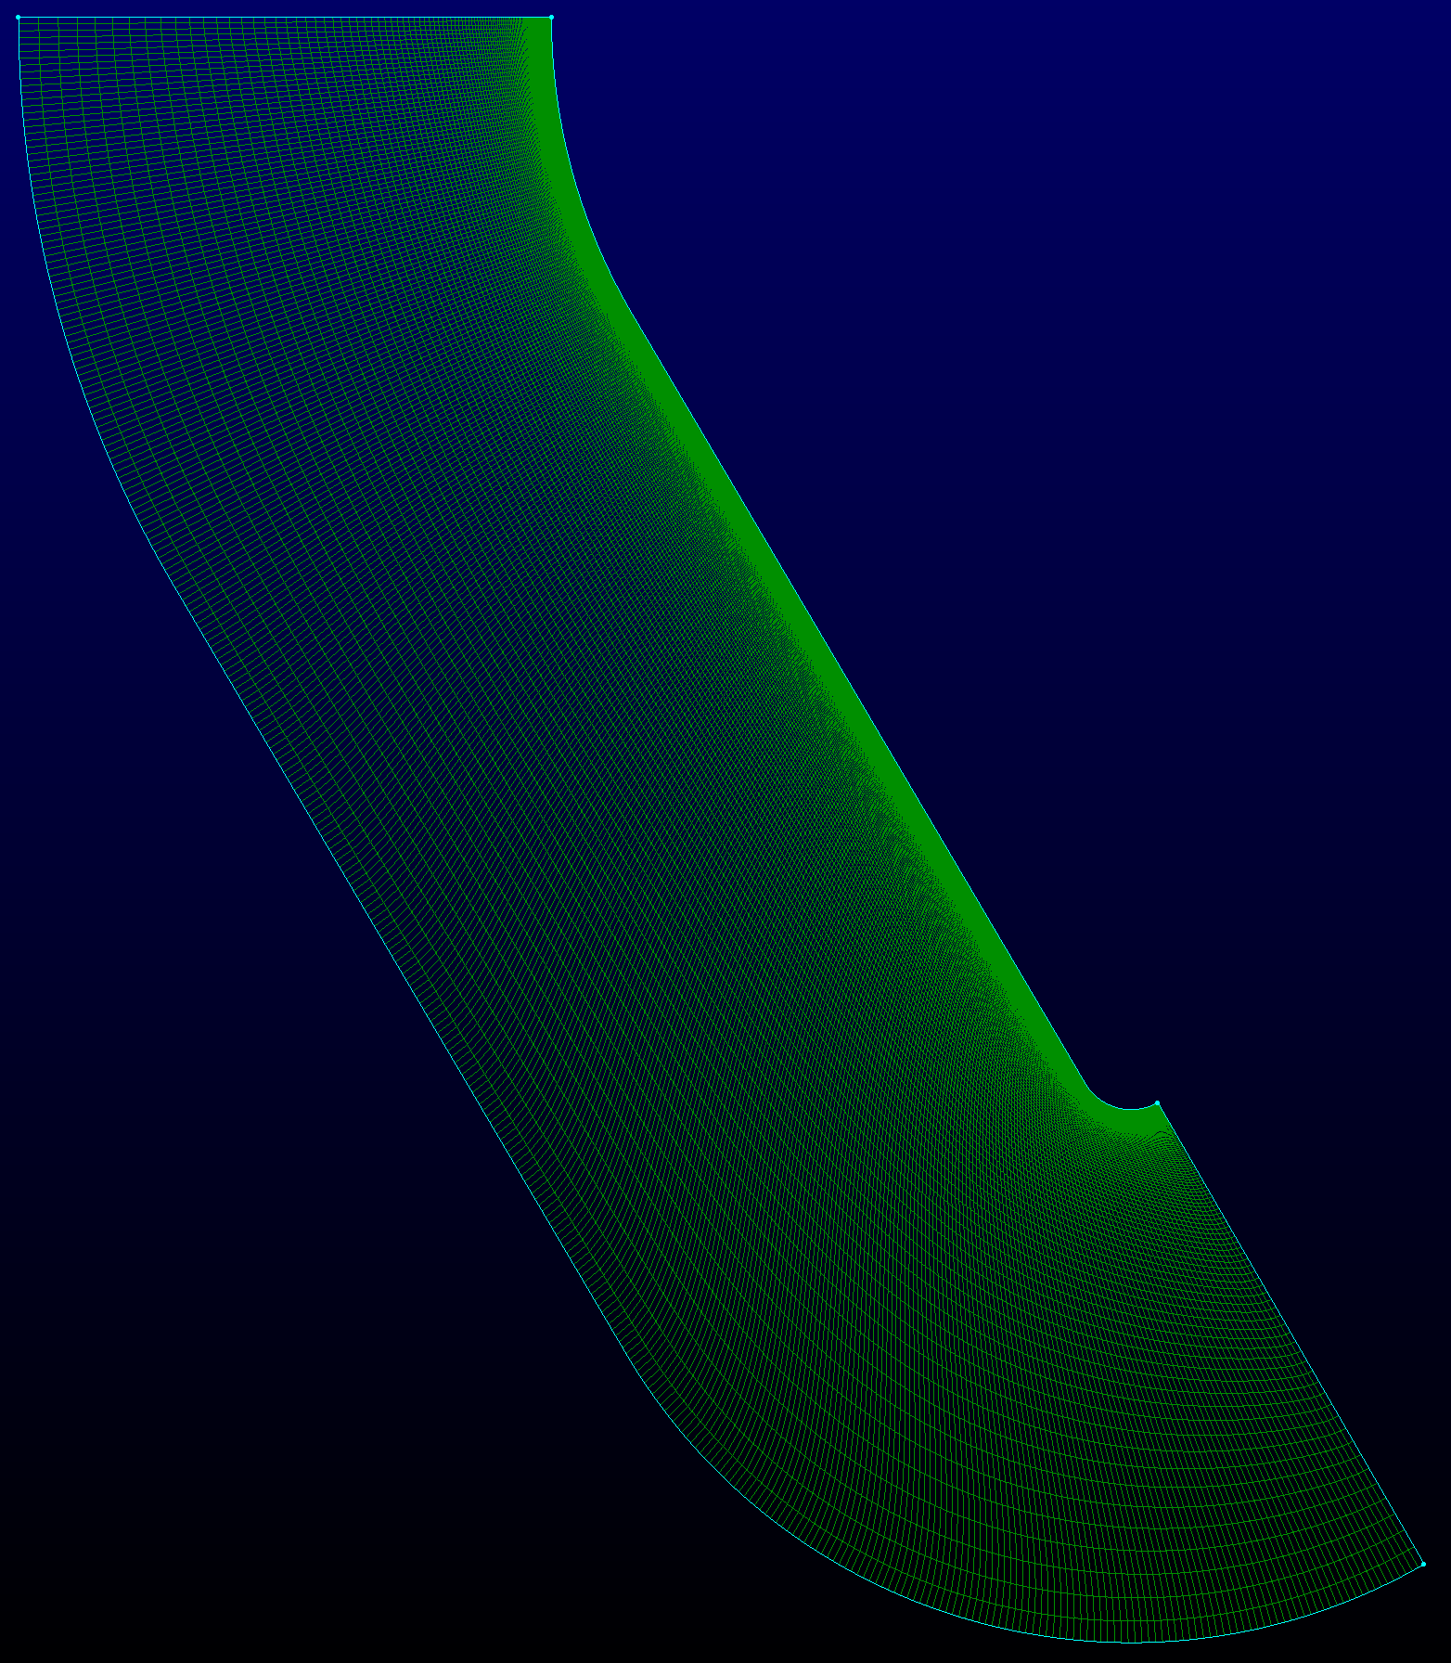
Meshing
81.1cm
Notes:
The left image here shows a capsule that is traveling right to left, and the final mesh that was used in the CFD solver. Since the capsule as an axis of rotational symmetry about the center line, a 2D mesh can be used rather than a 3D mesh. The mesh was also simplified by knowing that since the flow will be compressible due to the supersonic speeds of the capsule, the area behind the capsule can be ignored. These simplifications reduce the time needed to determine a solution. The right images shows one of the other attempts at at constructing a usable mesh. While it is more in line with meshes made by researchers performing similar analysis, it proved very susceptible to negative volume errors. The left mesh was the most successful, however I included this other mesh to show the design process. Through a convergence study, the simplest stable mesh was found to have 200 divisions along the line of symmetry, which is this line here *laser pointer*, and 250 divisions along the capsule surface here *laser pointer*

Slide 7
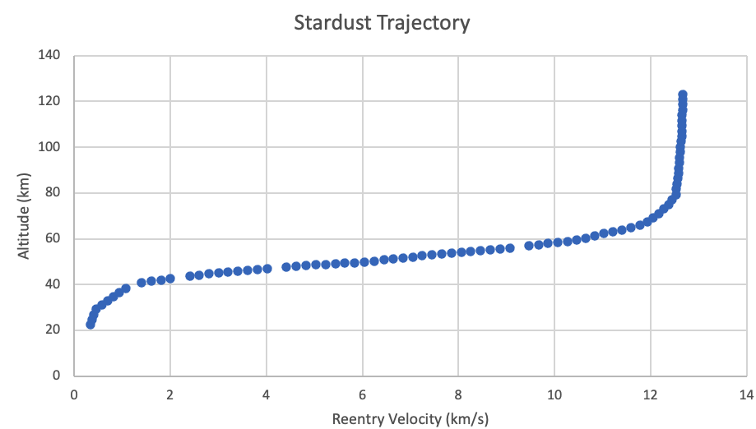

Initial Conditions
12.2 km/s
8.2$°$ entry angle
US Standard Atmosphere 1976
Notes:
CFD simulations reach solutions for specific initial conditions. For OSIRIS-REx these initial conditions describe the flight parameters. The capsule is expected to be travelling at 12.2 km/s when it arrives at Earth. At an altitude of 70km, this is equivalent to Mach 40, or 40 times the speed of sound. The capsule is also expected to enter the atmosphere at 8.2 degrees. Reentry vehicles want low reentry angles like this one to ensure that the force of hitting the atmosphere doesn’t destroy the capsule. The plot shown at the right shows the altitude versus velocity for a similar mission, called Stardust. Although this data is for a different capsule, due to identical capsule designs and nearly identical parameters of reentry, the plot can be used to determine reentry speed conditions. Atmospheric data was taken from a NASA document called the US standard atmosphere 1976. This was an extensive study that published data on the temperature, pressure, and density of air at any altitude you could want. These values were entered into the simulation software, and the simulations could begin. The goal was to run simulations where the capsule would be at 4, 8, and 12 km/s, using the corresponding atmosphere data.

Slide 8
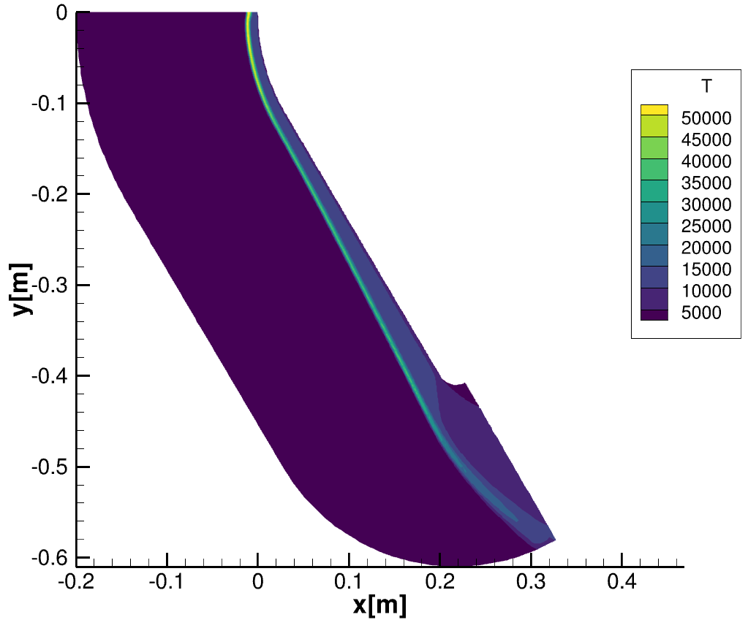
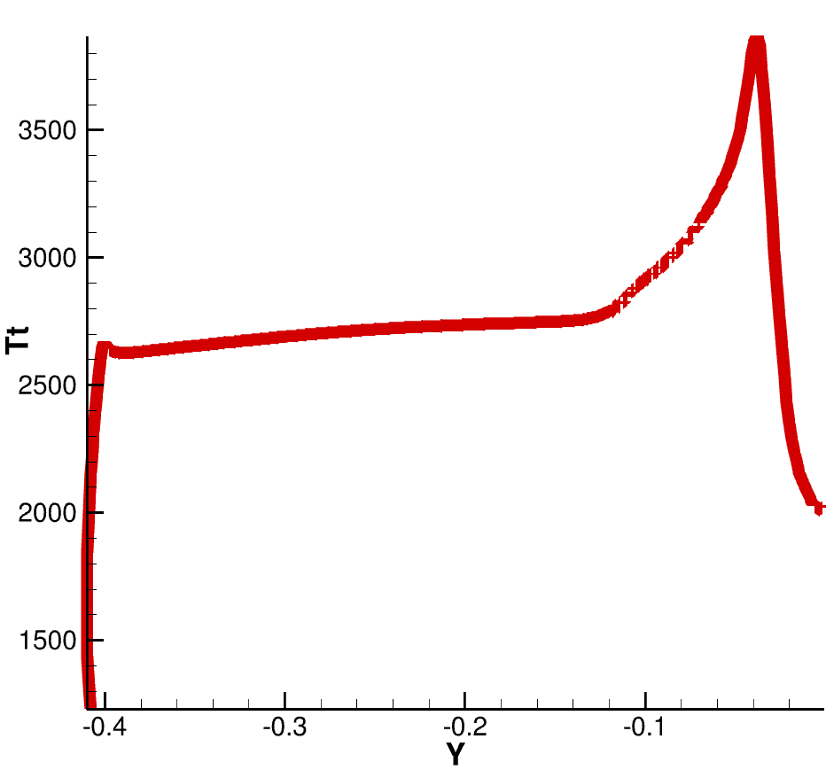
Results
Flow Temperature (K)
Wall Temperature (K) along Y-direction
Notes:
The figures here show the results from analysis at 70km altitude and 12 km/s. The left images shows the temperature distribution in front of the capsule, where the shock can clearly be seen. The right image shows the temperature of the capsules wall. As you can see the temperature spikes near the stagnation point. The maximum temperature is higher than expected, roughly 3800K here where it was closer to 3300K in similar published research. This is likely due to the higher speed used in this simulation as compared to other simulations.

Slide 9
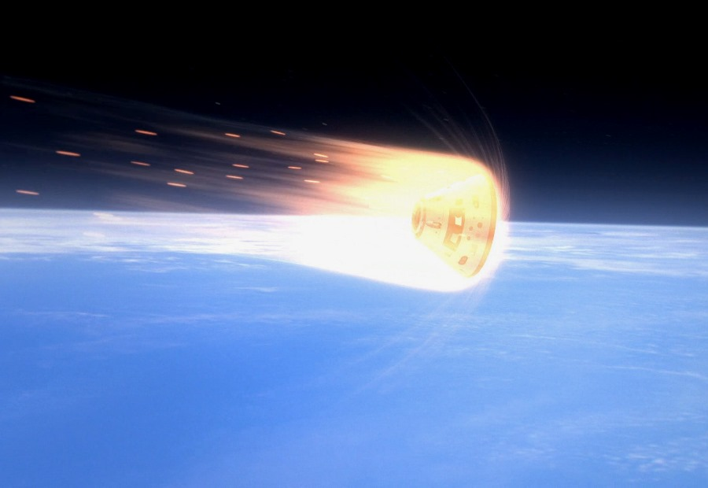
Challenges Faced
Time for the project
Meshing
Convergence
Time to run experiments
Notes:
Unfortunately, the simulations at 4 and 8 km/s did not reach a solution. I was planning on plotting the surface temperature of the capsule at multiple altitudes to create a temperature profile over time, which could then be compared to similar published figures. The initial goals for the analysis could not be met due to several issues faced. The time lost attempting to work with PATO left me with only 3 months to both learn LeMANS and complete the experiments. The next issue that was faced was the difficulty in creating a mesh. There are several iterations of meshes not shown in this presentation that either wouldn’t converge or would produce inaccurate solutions. Another issue was the convergence of the meshes. In the setup for each simulation, the amount of change per iteration had to be specified. This value proved to be extremely volatile, as a small value took to long to converge, and large values would reach unsolvable steps. Despite running over 100 simulations over roughly 10 thousand computer hours, only about 6 of them were able to be used to get data. The final major issue that I faced was the time it took to complete the simulations. The average run took almost two and a half days to complete, and in that time, I wouldn't know if the run would be successful or not. From all these issues came a lot of learning experience and things that could be improved upon.

Slide 10
Future Improvements
Mesh quality
Switch to working program sooner
Better understand convergence
Notes:
In the future I would like to spend more time looking into the mesh shape. A mesh like the ones published in similar research may converge faster than the mesh that I used, due to the smaller area and therefore less divisions within the mesh. Given more time I could resolve the errors in the mesh. Switching from PATO to LeMANS earlier would have afforded me significantly more time to find the best mesh, rather than taking the first mesh that could somewhat consistently reach a solution. With more time to run simulations I could have also gained a better understanding of the simulation convergence and improve the starting criteria of each simulation.

Slide 11
Thank You
Notes:
Thank you for your time.

